Slide 1

Chapter 3 – part I

Slide 2
OUTLINE
  Position, velocity, acceleration vectors.
  Projectile motion.
  Problems.

Slide 3
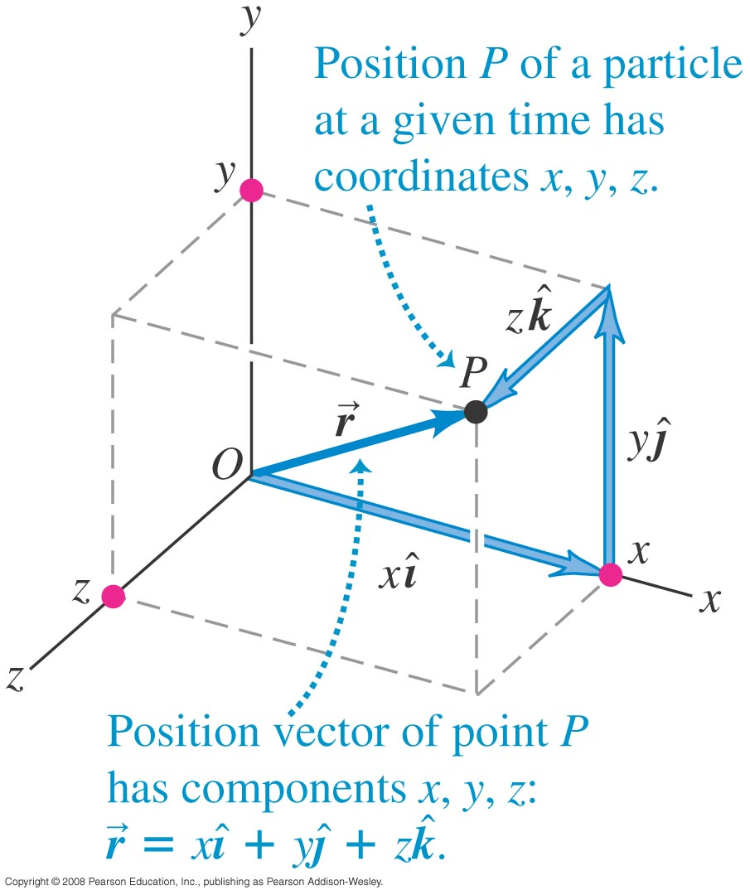
Position vector
  The position vector from the origin to point P has components x, y, and z.

Slide 4
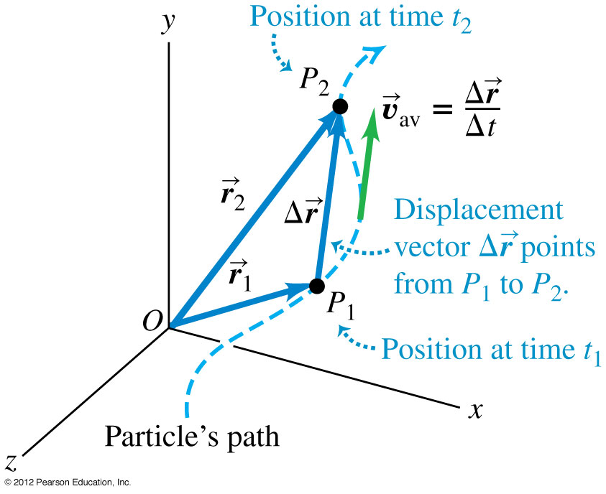
Average velocity
  The average velocity between two points is the displacement divided by the time interval between the two points, and it has the same direction as the displacement.

Slide 5
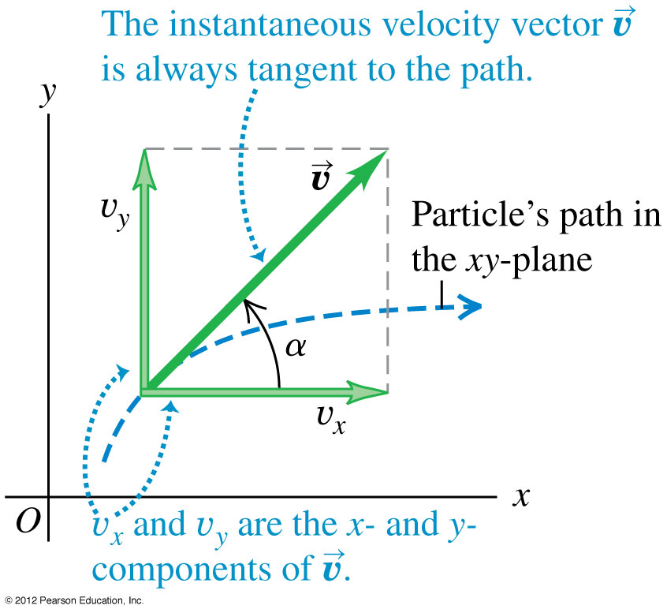

Instantaneous velocity
  The instantaneous velocity is the instantaneous rate of change of position vector with respect to time.
  The instantaneous velocity of a particle is always tangent to its path.

Slide 6
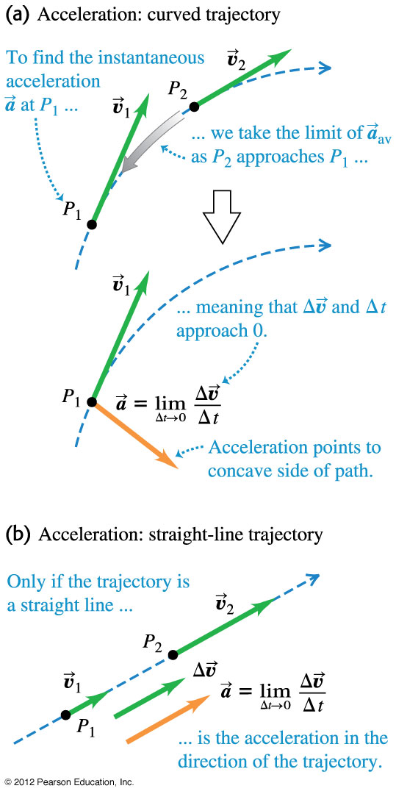

Instantaneous acceleration
  The instantaneous acceleration is the instantaneous rate of change of the velocity with respect to time.
  Any particle following a curved path is accelerating, even if it has constant speed.

Slide 7
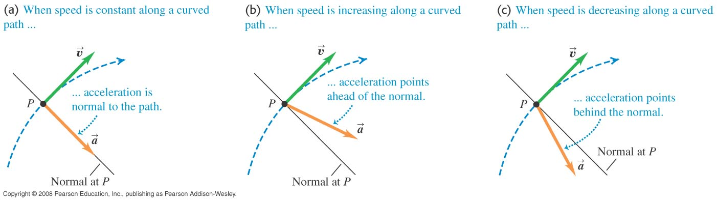
Direction of the acceleration vector
  The direction of the acceleration vector depends on whether the speed is constant, increasing, or decreasing.

Slide 8
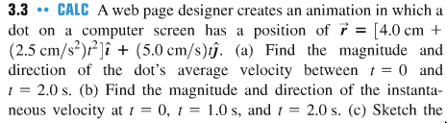
Problem #1
(c) Find the magnitude and direction of the instantaneous acceleration at t = 0 and
t = 2.0 s.

Slide 9
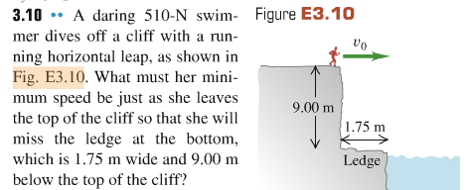
Problem #2

Slide 10
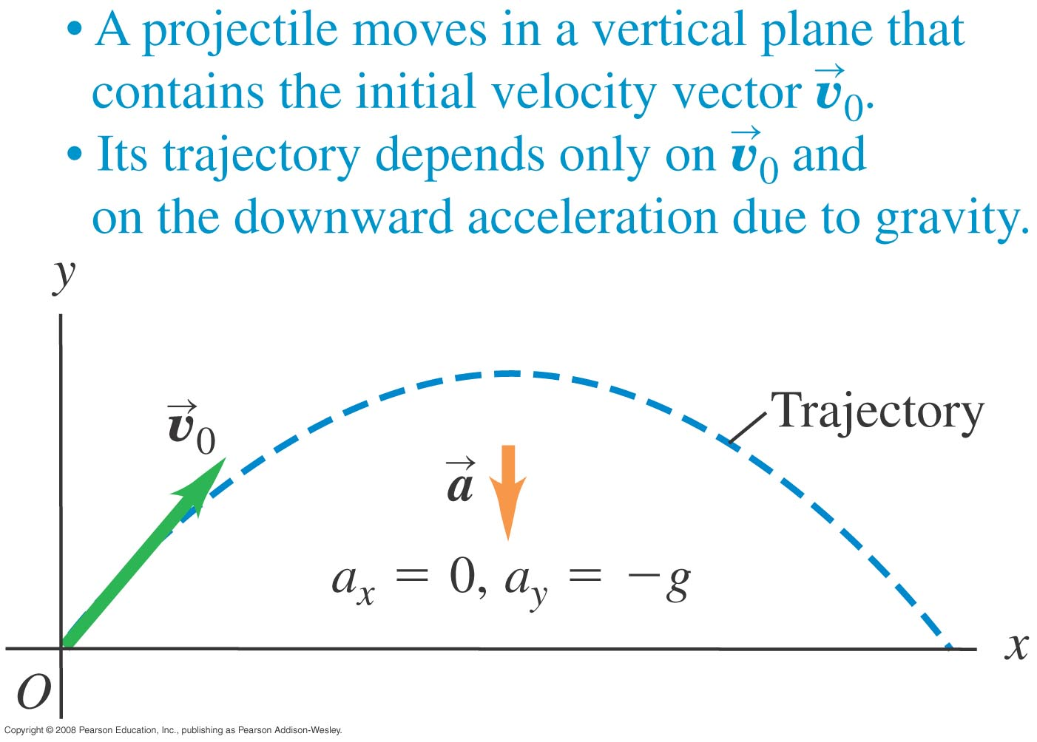
Projectile motion
  A projectile is any body given an initial velocity that then follows a path determined by the effects of gravity and air resistance.
  Begin by neglecting resistance and the curvature and rotation of the earth.

Slide 11


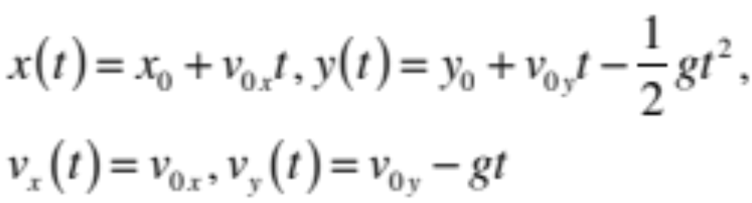
Projectile motion
y
gravity
v₀
y_{f}
y₀
x₀
x_{f}
x

Slide 12
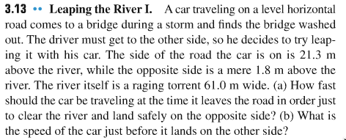
Problem #3

Slide 13
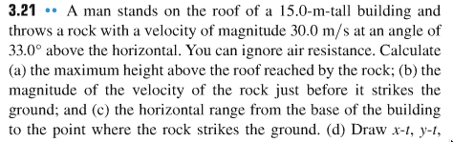
Problem #4

Slide 14
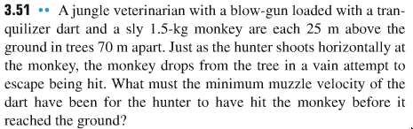
Problem #5

